Slide 1
Spring 2021 Immigration Essentials
Center for International Services

Slide 2
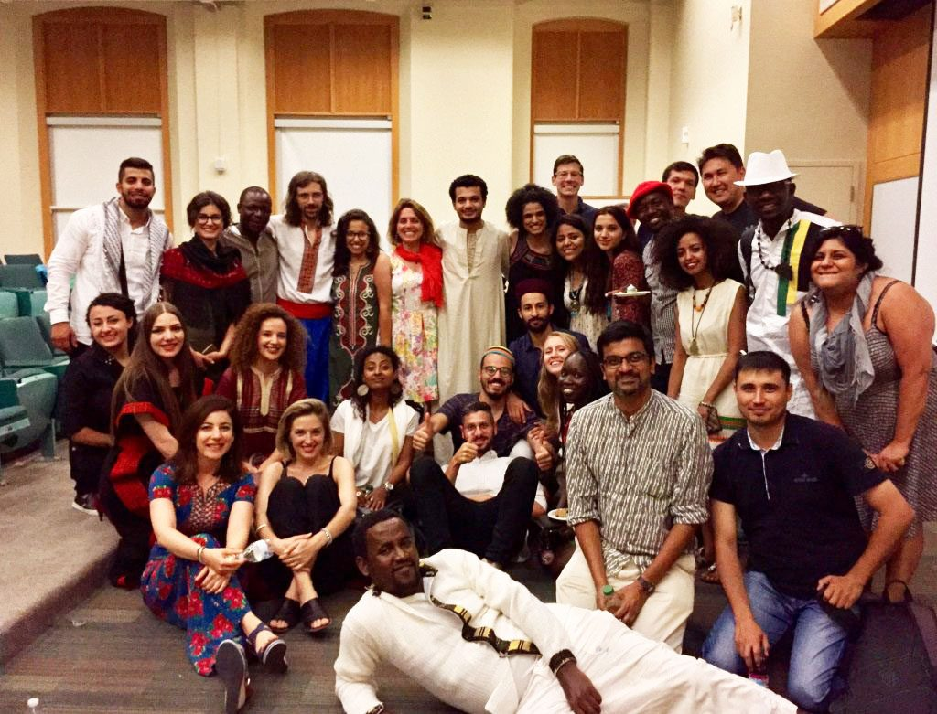
International Student Population at SU
2019-2020
Total Student Enrollment: 22,850
Total International Students: 4,302
Undergraduate Student Enrollment: 15,275
International Undergraduate Students: 2,139
Graduate Student Enrollment: 7,575
International Graduate Students: 2,163
OPT Applications Processed: 2019- 780; 2020- 673
STEM OPT Applications Processed: 2019-374; 2020-410
CPT Applications Processed: 2019-517; 2020-304
Center for International Services

Slide 3
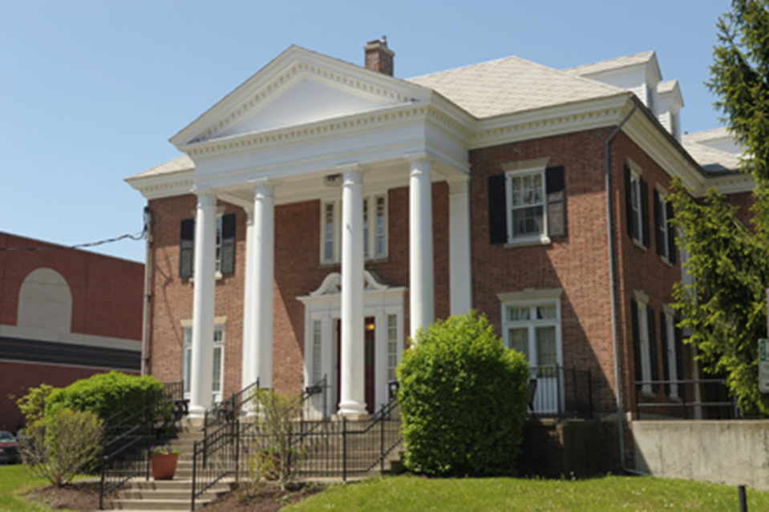
Center for International Services
310 Walnut Place
corner of Walnut Place and Waverly Avenue
across the street from Bird Library and Schine Student Center
Hours:
Monday-Friday
8:30 am - 5:00 pm
Summer: 8:00 am - 4:30 pm
Phone: 315-443-2457
Email: international@syr.edu
Website: international.syr.edu
Center for International Services

Slide 4
Center for International Services
Advisor on Call:
Monday-Friday, 11 am-3 pm
In person, By Phone, via Zoom, Teams, or Skype
Informational Seminars:
Curricular and Optional Practical Training
1st & 3rd Wednesday, 2nd Friday every month
In person and via Zoom
Newsletter –every other week
Center for International Services

Slide 5
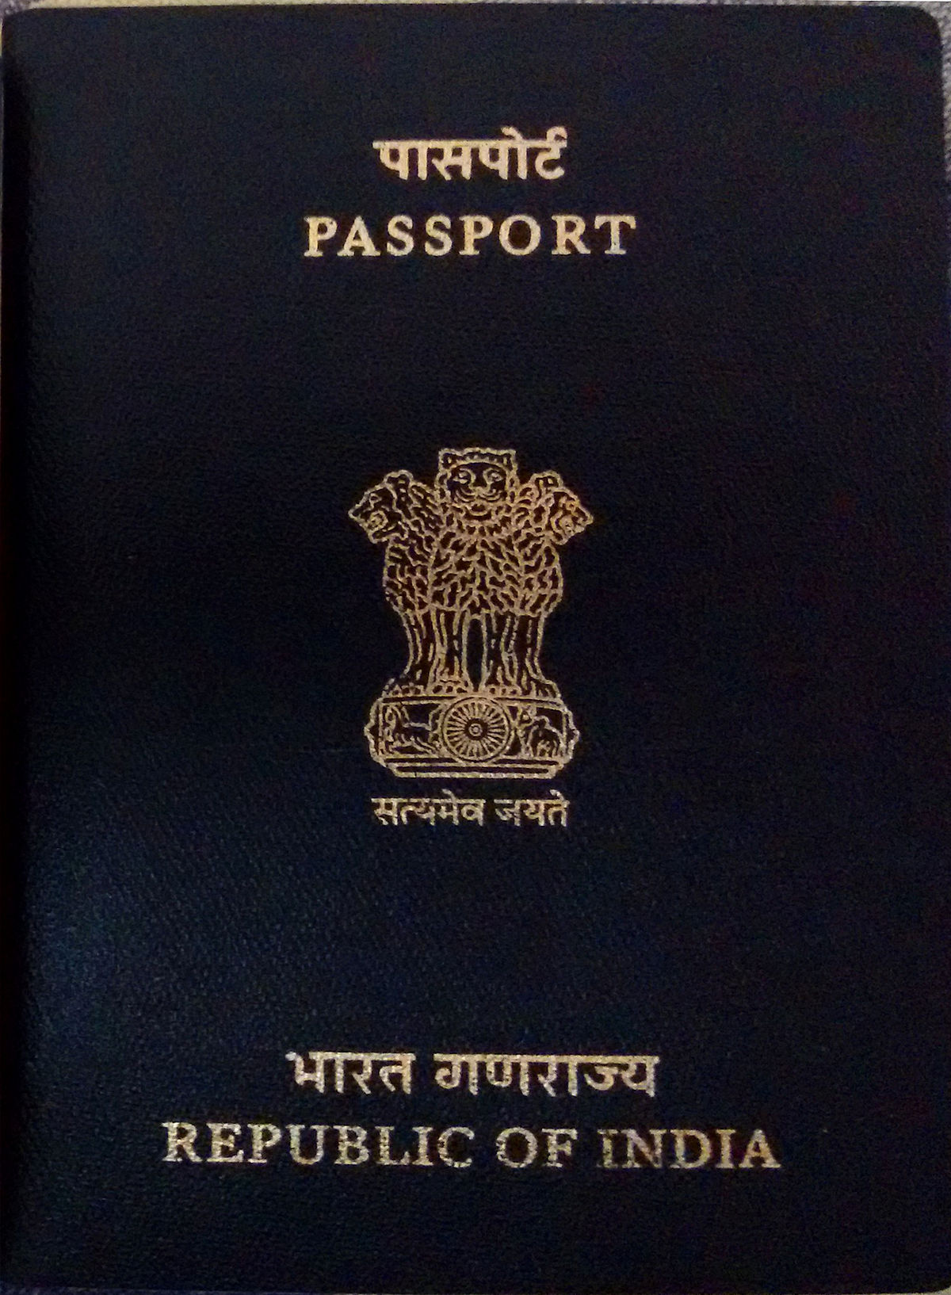
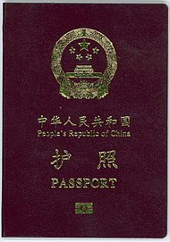
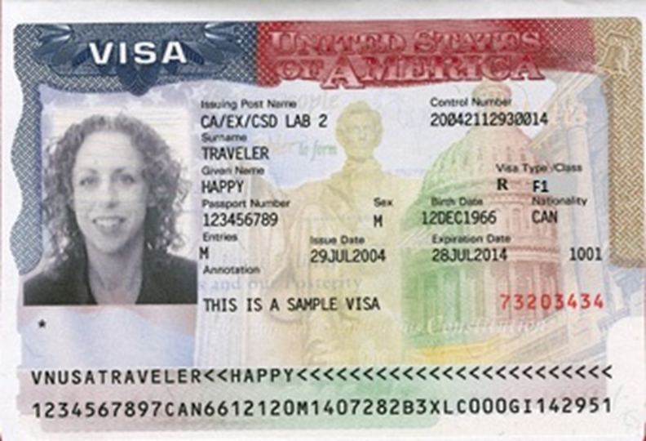
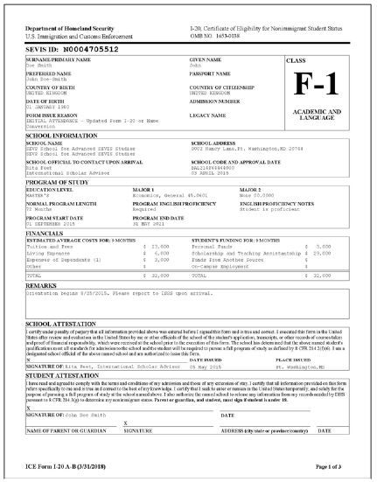
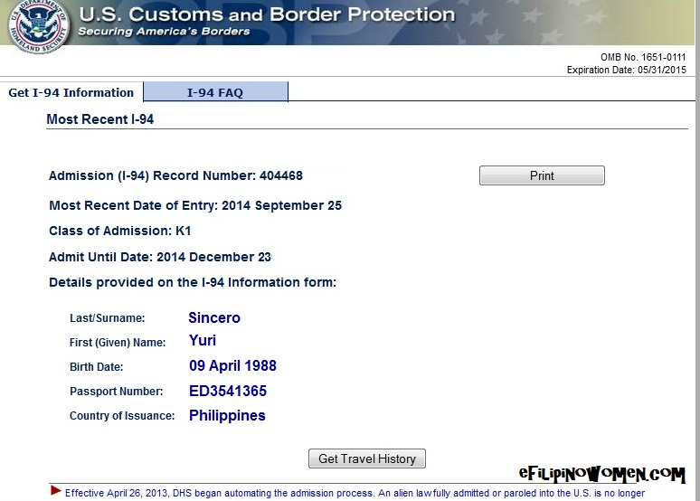
Tour of Documents
Center for International Services

Slide 6
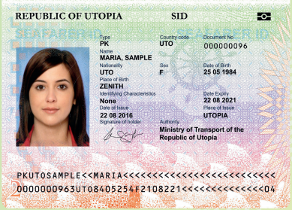
Passport
Know your passport expiration date
Your passport needs to be valid for at least 6 months into the future when entering the U.S.
Replace at your Consulate in New York City or Embassy in Washington, DC
Center for International Services

Slide 7
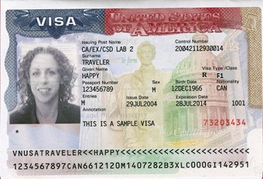
Visa
Know expiration date and Number of entries
Needs to be valid when entering the U.S.
Number of entries and length determined by diplomatic agreements
Can only be renewed at a U.S. Embassy or Consulate-all located outside the U.S.
Visa cannot be renewed inside the U.S.
Can expire while in the U.S.
Center for International Services

Slide 8
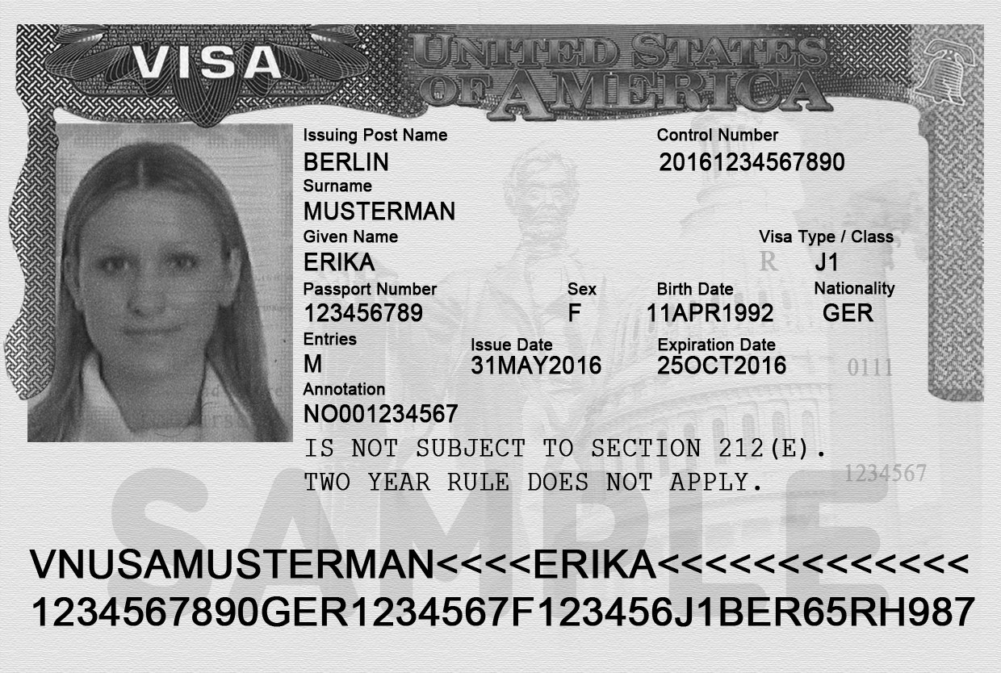
Two Year Home Residency Requirement
Some people in J status are subject to a Two Year Home Residency Requirement: the facts of your situation matter, not necessarily what it says on your visa
If you received government funding for your J program
If your country has your field of study on its Exchange Visitor Skills List
If your J program is for a Medical Residency Program
Center for International Services

Slide 9
Two Year Home Residency Requirement
If you are subject to the Two Year Home Residency Requirement:
cannot change status within the U.S.
are not eligible for an H, K or L visa
are not eligible for permanent residence in the U.S.
UNTIL you have been physically present in your home country for two years
Center for International Services

Slide 10
Travel
Visa needs to be valid to enter the U.S.
Exception:
Returning to the U.S. after a trip to Canada, Mexico, or the adjacent islands
Trip of less than 30 days
Trip solely to Canada, Mexico, or the adjacent islands
Cannot apply for U.S. Visa while there
Not a citizen of Iran, Syria, Sudan, or North Korea
Center for International Services

Slide 11
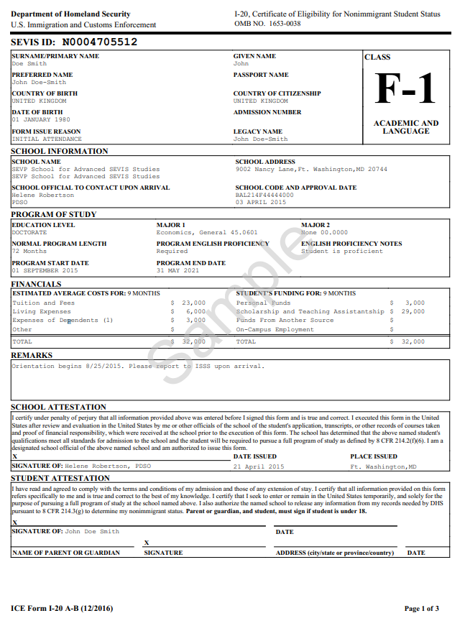
I-20
Immigration Selfie-tells your story
Issued by Syracuse University
Biographic Information about you
Degree Level
Program of Study
Program Start and End Date
Financial Information
Center for International Services

Slide 12
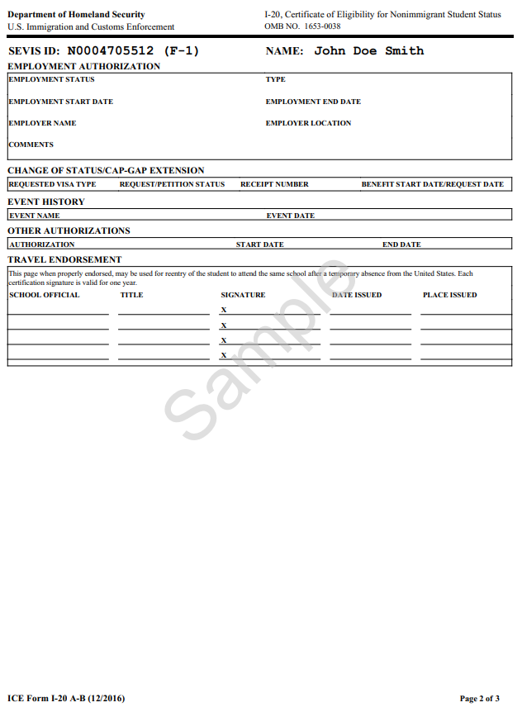
I-20 - Page 2
Employment Authorizations
Travel Endorsement
Travel Signatures-valid for one year/12 months
Ann Dievendorf International Student Advisor 03/10/2021 Syracuse,NY
Travel Signatures- Monday-Friday
March 8-12
9 am-4 pm Bird Library
Center for International Services

Slide 13
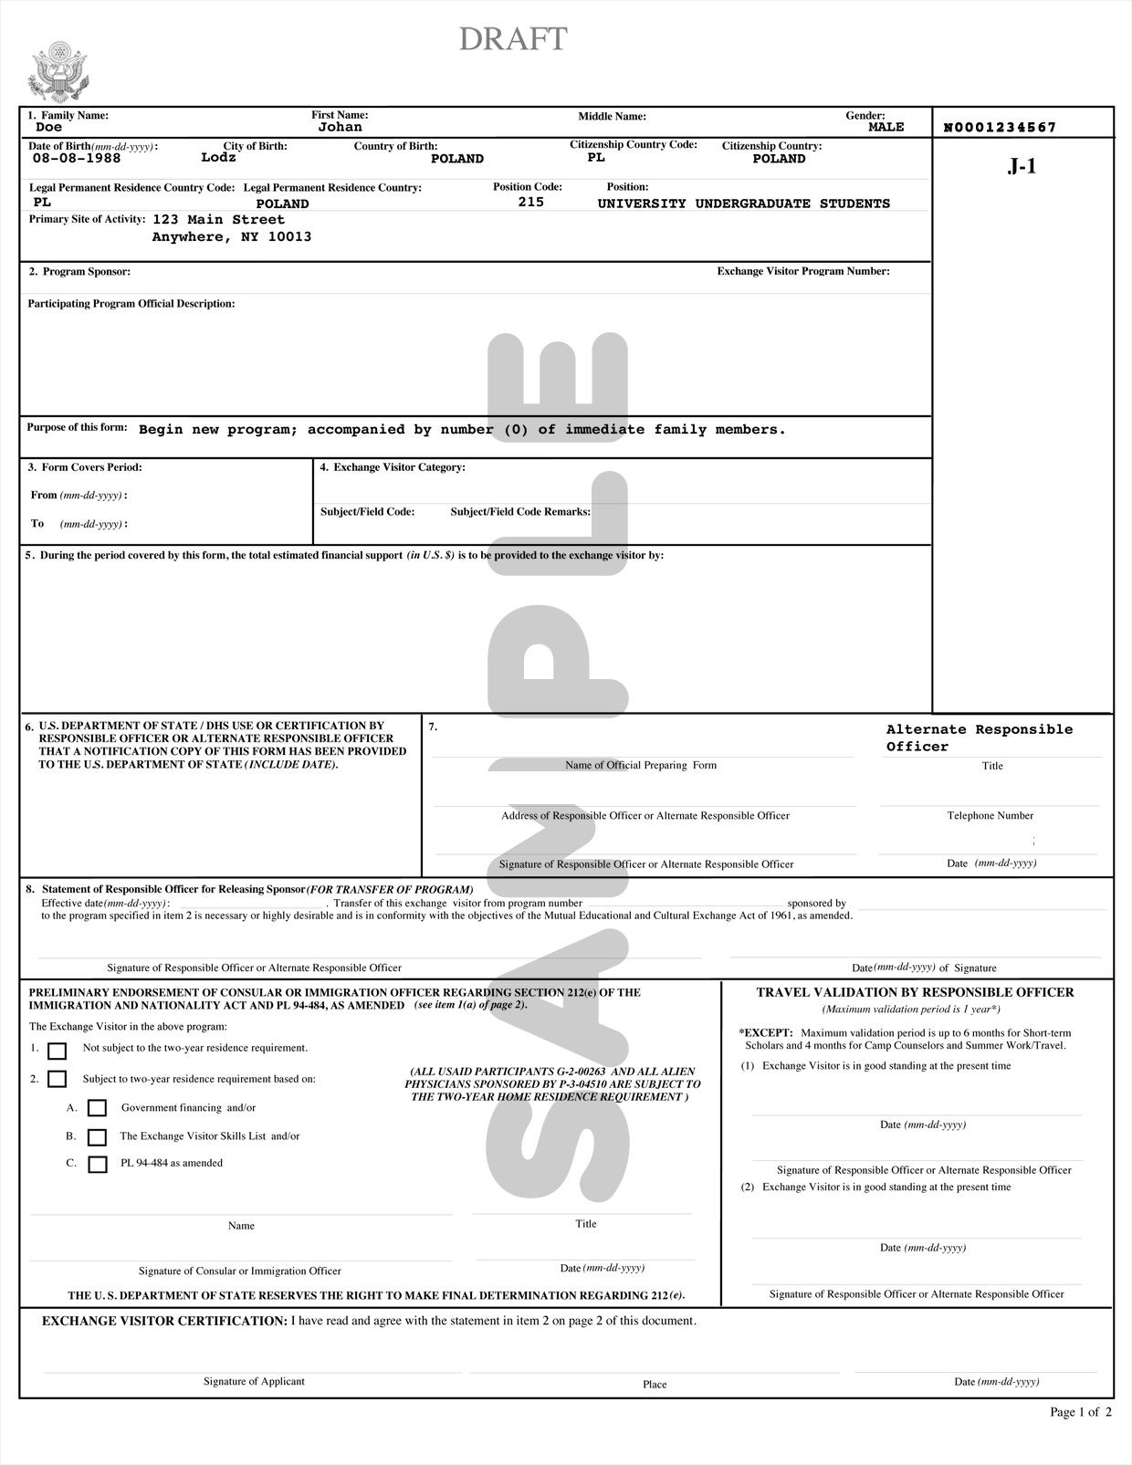
DS-2019
Immigration Selfie-tells your story
Issued by Syracuse University or J-1 Program Sponsor
Biographic Information about you
Degree Level
Program of Study
Program Start and End Date
Financial Information
Center for International Services

Slide 14
Travel Endorsement
Travel Signatures-valid for one year/12 months
Travel Signatures- Monday-Friday, March 8-12
9 am-4 pm Bird Library
03/10/2021
Center for International Services

Slide 15
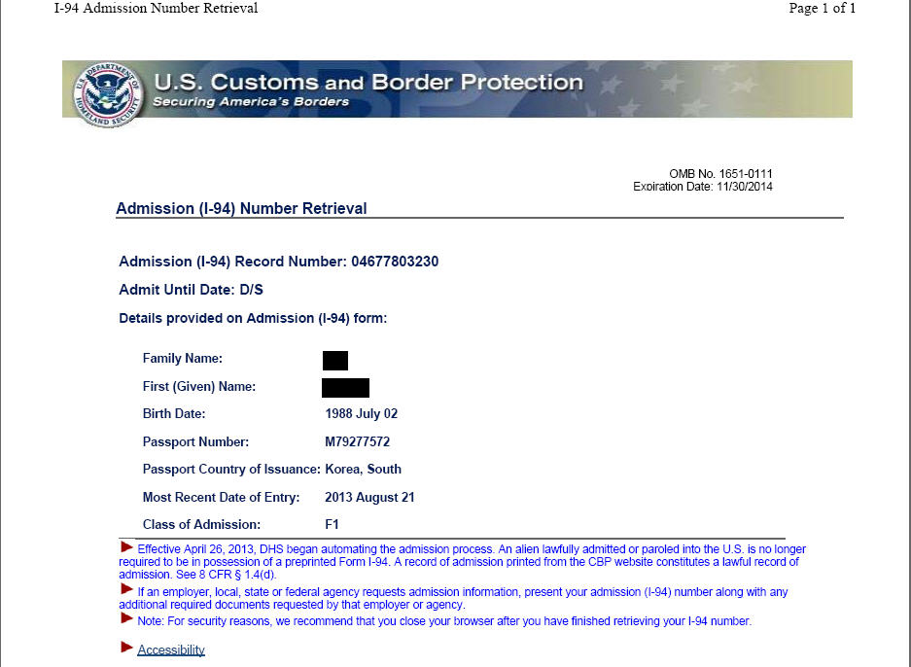
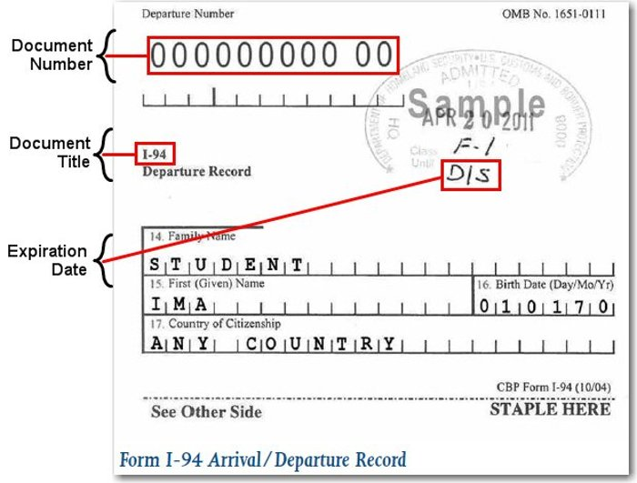
I-94 Arrival Record/Travel History
www.cbp.gov/I-94
Updated every time you travel out of the U.S. and enter
Check every time to be sure you were admitted to the US in F-1 status and for D/S
D/S = Duration of Status
Program End Date + 60 days to prepare to depart or change status
Center for International Services

Slide 16
3 Do’s and a Don’t
DO - Keep your Documents valid
DO - Update your Information
DO - Register Full-time every semester
Don’t - Engage in unauthorized Employment
Center for International Services

Slide 17
D
Keep Your
ocuments valid!
I
Update Your
nformation!
F
Register
ull-time every semester!
E
Do not engage in unauthorized
mployment!
Center for International Services

Slide 18
Documents
Passport:
Keep your passport valid at all times
must be valid for 6 months into the future when entering the U.S. unless a citizen of the 6 month club
Visa:
Must be valid when entering the U.S.
Can expire while in the U.S.
I-94:
Check every time you enter the U.S.
F-1/J-1
D/S
I-20/DS-2019:
Program of Study
Program End Date
Travel Signature
Center for International Services

Slide 19
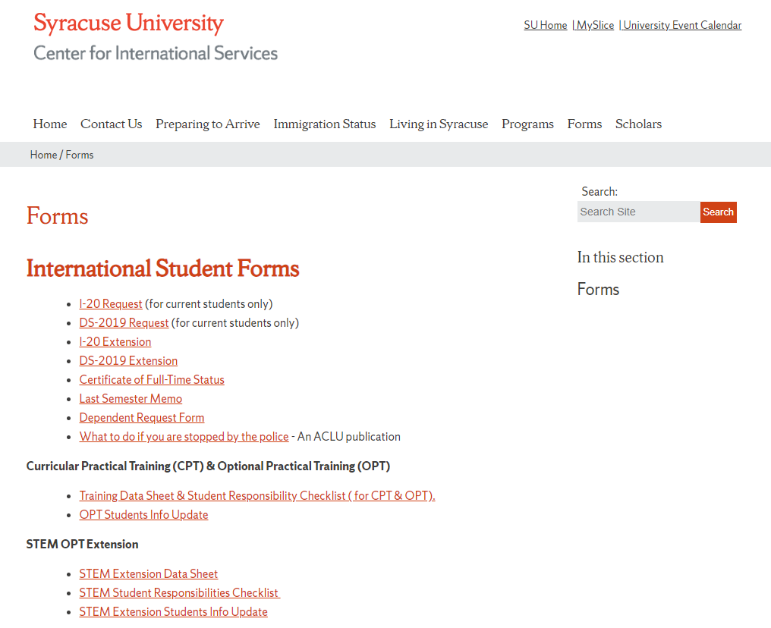
Program
Change Level of Study (Masters to Ph.D. or Ph.D. to Masters)
Program of Study (Computer Science to Computer Engineering)
I-20/DS-2019 Request on the Center for International Services Website
Center for International Services

Slide 20
Program End Date
If you need less time
changed when finish
If your need more time
I-20/DS-2019 Extension Request on the Center for International Services Website
Center for International Services

Slide 21
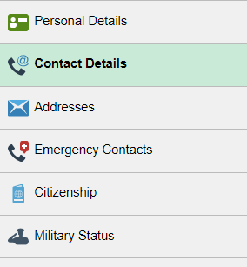
Information in MySlice
Name
Address
Current-here in Syracuse
Permanent-outside the U.S.
Phone Number
Emergency Contact Information
Center for International Services

Slide 22
Full-time Registration
Grad Students-9 credit hours each Fall and Spring semester
Usual Rule: Only one course can be taken online toward full-time registration (3 credits out of 9)
Spring 2021: New students (not enrolled in the U.S. in March 2020) have the one online course limit relaxed; but cannot be 100% online; Continuing students (were enrolled in the U.S. in March 2020) can be registered for all online classes
Summer registration not required by immigration regulations
Center for International Services

Slide 23
Full-time Registration
Exceptions:
This Spring 2021 semester: exempted from limitation of one online course rule
Final semester-can be registered for less than 9 credits if you need less than 9 credits to complete your degree-need Last Semester Memo
Teaching and Research Assistants
Certificate of Full-time Status
working on thesis or dissertation
studying for a qualifying exam
Internship
Center for International Services

Slide 24
Full-time Registration
Undergraduates-12 credit hours each Fall and Spring
Usual Rule: Only one course can be taken online toward full-time registration (3 credits out of 12)
Spring 2021: New students (not enrolled in the U.S. in March 2020) have the one online course limit relaxed; but cannot be 100% online; Continuing students (were enrolled in the U.S. in March 2020) can be registered for all online classes
Summer registration not required by immigration regulations
Center for International Services

Slide 25
Full-time Registration
Exceptions:
This Spring 2021 semester: exempted from the one online course limit
Final semester-can be registered for less than 12 credits if you need less than 12 credits to complete your degree-need Last Semester Memo
Center for International Services

Slide 26
Full-time Registration
Other Special Exceptions:
First Semester
Difficulty with English Language
Unfamiliarity with American teaching methods
Improper Course Placement
Must be documented by faculty member in writing
Medical Reasons
Must be documented by licensed medical doctor, doctor of osteopathy, or licensed clinical psychologist
Consult with an advisor from the Center for International Services first!
Center for International Services

Slide 27
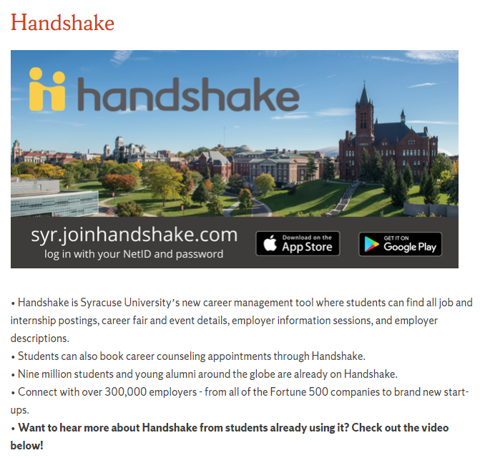
Employment
First Year (two semesters) in F-1 status limited to On campus employment
20 hours per week while school is in session; full-time during breaks
On Campus means on SU’s campus; paid by SU
Handshake
Center for International Services

Slide 28
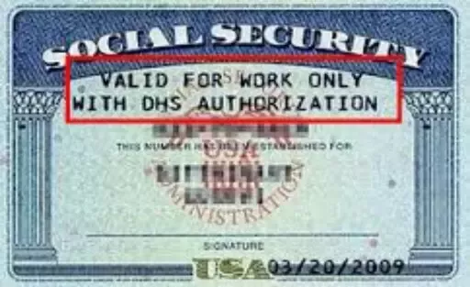
Social Security Numbers
Used for the purpose of tracking income to be taxed appropriately and eventually to earn retirement income
Only eligible if working/employed-not needed to begin working
Not needed to open a bank account, get a drivers license or obtain a credit card
Is not proof of identity – No photo on the card
Social Security Administration Offices are CLOSED-Social Security Number applications have to be done by mail through the Center for International Services
If you are hired on campus, Payroll will let the Center know and we will contact you with instructions
Center for International Services

Slide 29
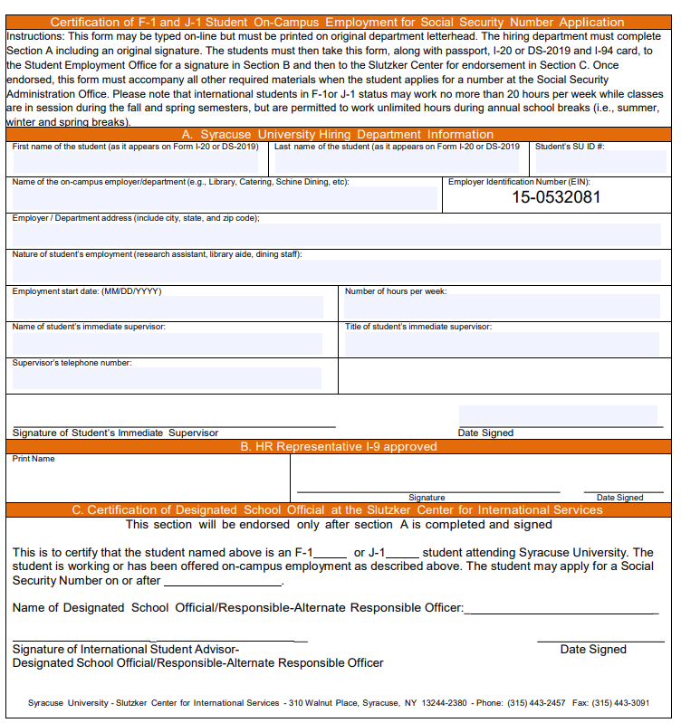
Employment
On Campus Employment
F-1 and J-1 students may work on campus up to 20 hours per work while school is in session, full-time during breaks
Handshake
Employer Verification Form (EVF)-needed to apply for SSN
The Center for International Services will contact you when we receive an EVF from Student Employment and you are able to apply for an SSN
Center for International Services

Slide 30
Employment
After two semesters (Fall and Spring, Spring and Fall)
Eligible for
F-1s
Curricular Practical Training
Optional Practical Training
Economic Necessity
J-1s
Academic Training
Economic Necessity
Curricular
Practical
Training
Optional
Practical
Training
Center for International Services

Slide 31
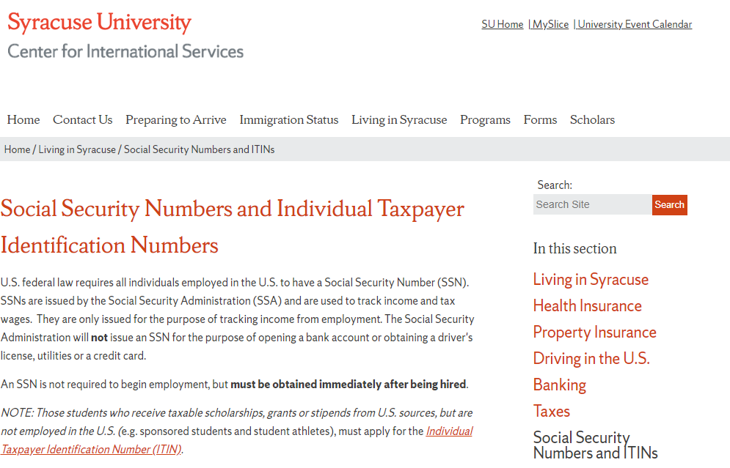
Individual Taxpayer Identification Numbers (ITINs)
Fellowship and Scholarship holders only
NOT if only receiving a reduction in your tuition that may be called a scholarship on your I-20
Information on the Center for International Services website website
Center for International Services

Slide 32
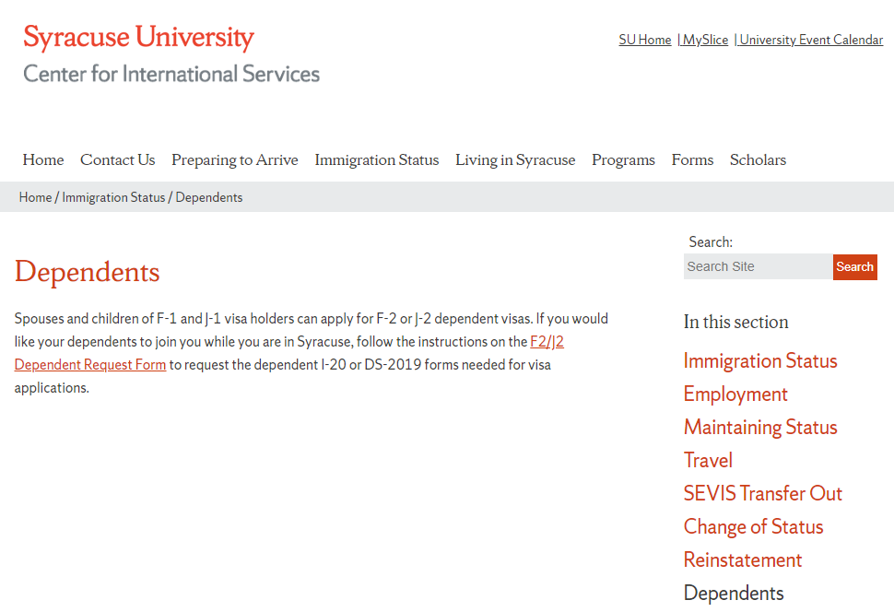
Dependents
Spouses and Children under 21 yrs. of age-not mother, father, sister, brother, grandma, etc.
Dependent Request Form on the Center for International Services website
Must submit financial support documentation & health insurance to bring dependents
Their legal status is linked to your status
F-2s cannot seek employment; J-2s can
F-2s cannot enroll in full-time course of study or degree program, except K-12; J-2s can enroll full-time
Center for International Services

Slide 33
Leaves of Absence
Medical:
Must submit written recommendation from a licensed physician, clinical psychologist or doctor of osteopathy
May remain in the U.S. while on an approved Medical Leave of Absence
Personal:
Must begin with academic department
F-1 status will be terminated
May not remain in the U.S. while on a Personal Leave of Absence
Center for International Services

Slide 34
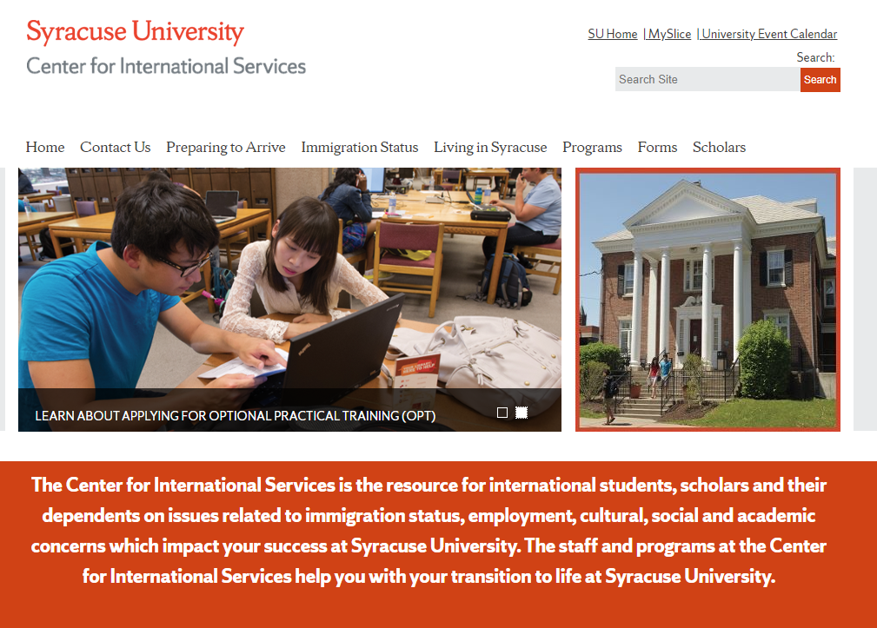
international.syr.edu
Center for International Services

