Slide 1
Fall 2021 Immigration Essentials- Part 1
Center for International Services

Slide 2
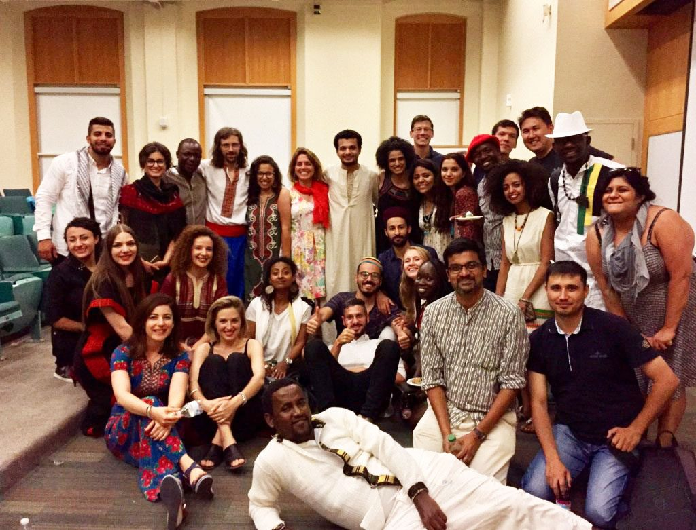
International Student Population at SU
2020-2021; 2019-2020
Total Student Enrollment: 21,322; 22,850
Total International Students: 3,748; 4,302
Undergraduate Student Enrollment: 14, 479; 15,275
International Undergraduate Students: 2,034; 2,139
Graduate Student Enrollment: 6,193; 7,575
International Graduate Students: 1,681; 2,163
OPT Applications Processed: 2020- 673; 2019- 780
STEM OPT Applications Processed: 2020-419; 2019-374
CPT Applications Processed: 2020-304; 2019-517
Center for International Services

Slide 3
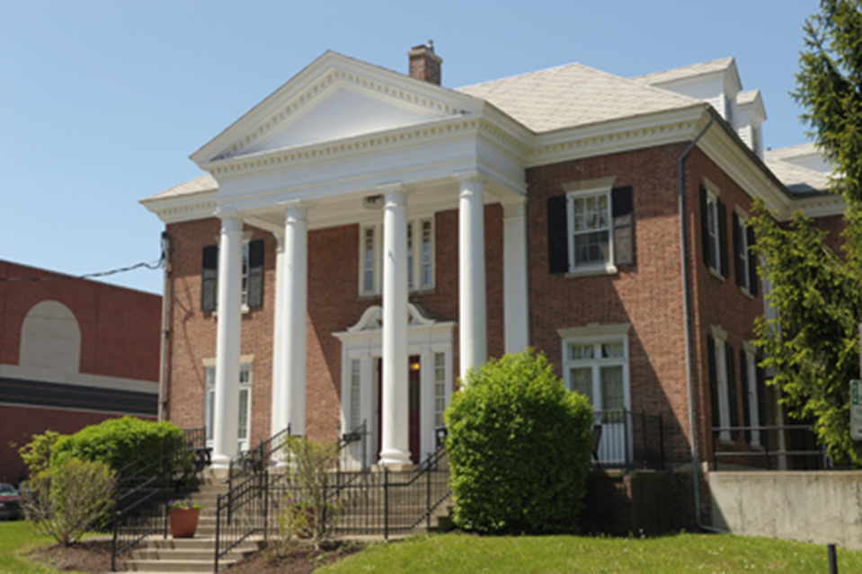
Center for International Services
310 Walnut Place
corner of Walnut Place and Waverly Avenue
across the street from Bird Library and Schine Student Center
Hours:
Monday-Friday
8:30 am - 5:00 pm
Summer: 8:00 am - 4:30 pm
Phone: 315-443-2457
Email: international@syr.edu
Website: international.syr.edu
Center for International Services

Slide 4
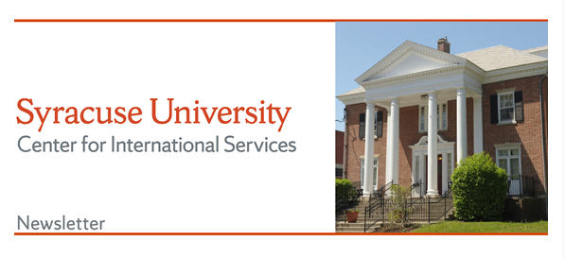
Center for International Services Continued
Advisor on Call:
Monday-Friday, 11 am-3 pm
In person, By Phone, via Zoom, Teams, or Skype
Informational Seminars:
Curricular and Optional Practical Training
1st & 3rd Wednesday, 2nd Friday every month
In person and via Zoom (this summer)
Newsletter –every other week
CPT
Center for International Services

Slide 5
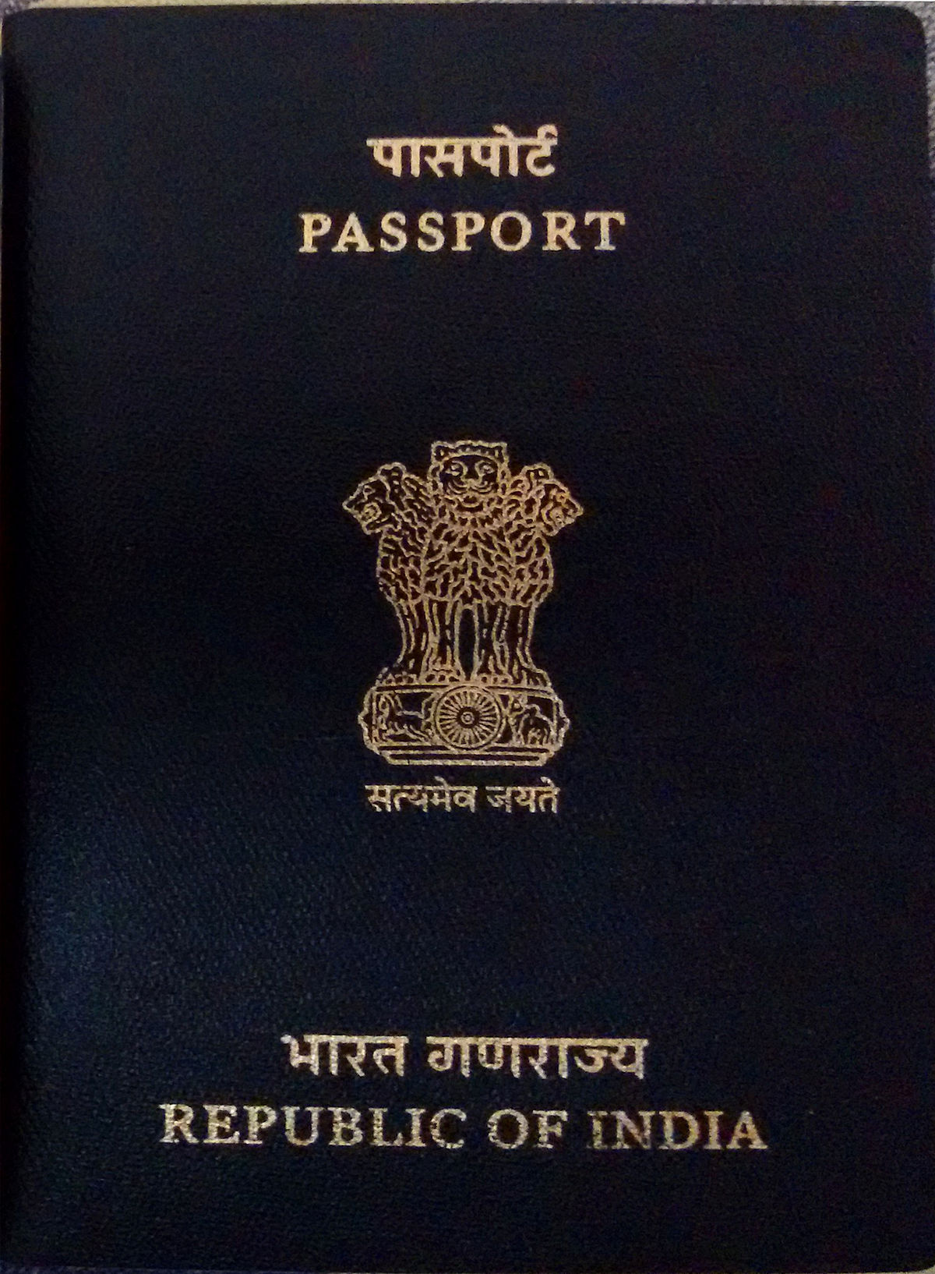
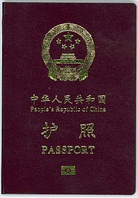
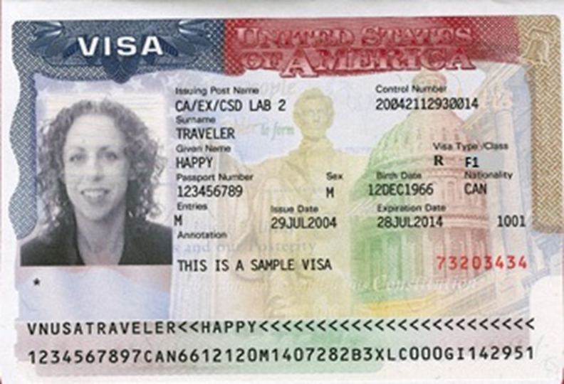
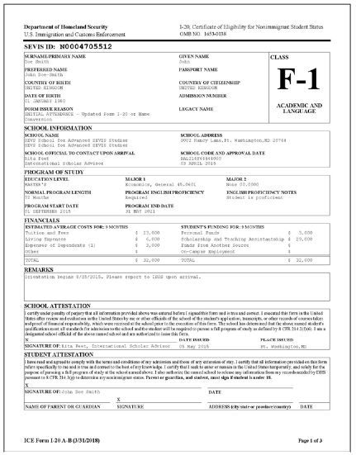
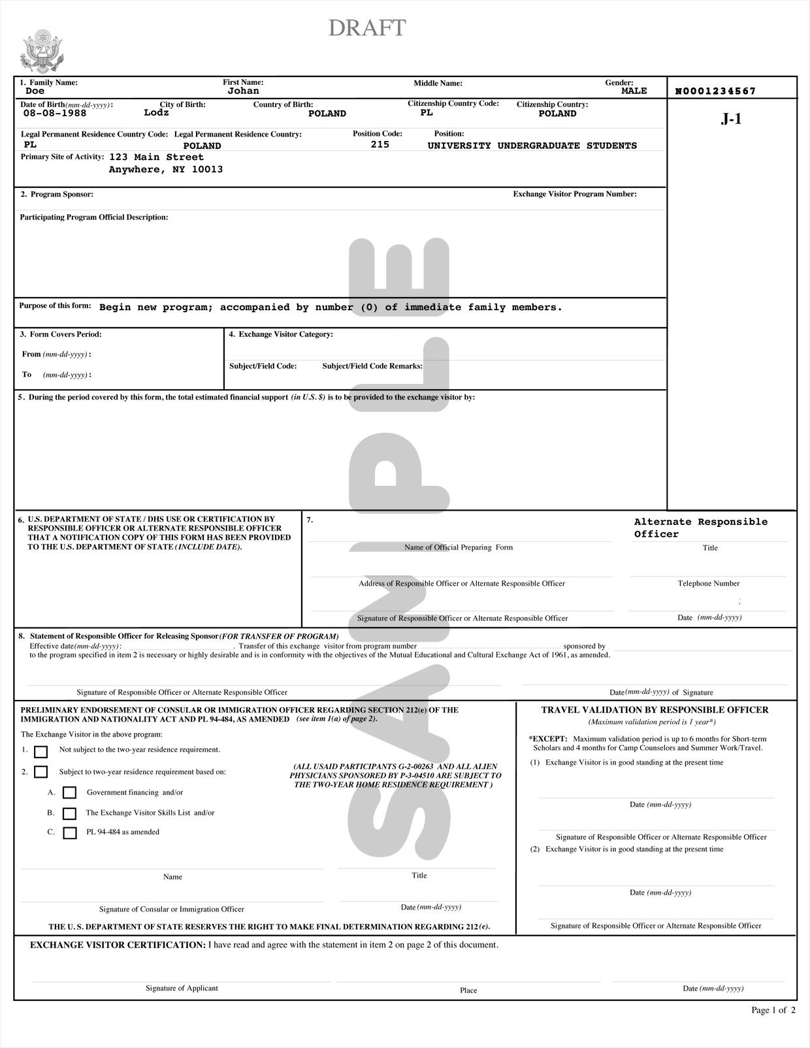
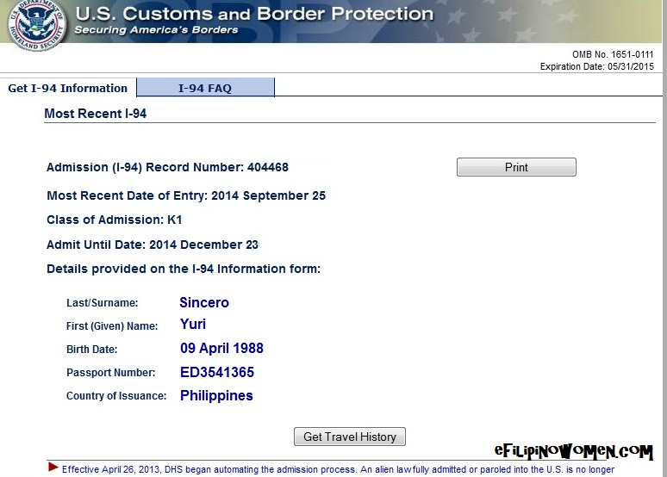
Tour of Documents
Center for International Services

Slide 6
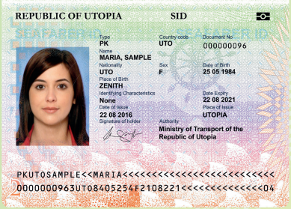
Passport
Know your passport expiration date
Your passport needs to be valid for at least 6 months into the future when entering the U.S.
Replace at your Consulate in New York City or Embassy in Washington, DC
Center for International Services

Slide 7
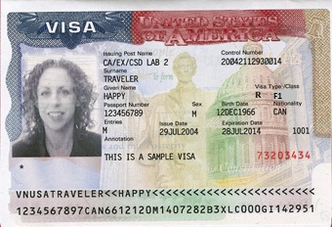
Visa
Know expiration date and Number of entries
Needs to be valid when entering the U.S.
Number of entries and length determined by diplomatic agreements
Usually annotated with SEVIS Number
Usually annotated with school or J-1 Program Sponsor Name and Number (SU=P-1-00245)
Can only be renewed at a U.S. Embassy or Consulate-all located outside the U.S.
Visa cannot be renewed inside the U.S.
Can expire while in the U.S.
Center for International Services

Slide 8
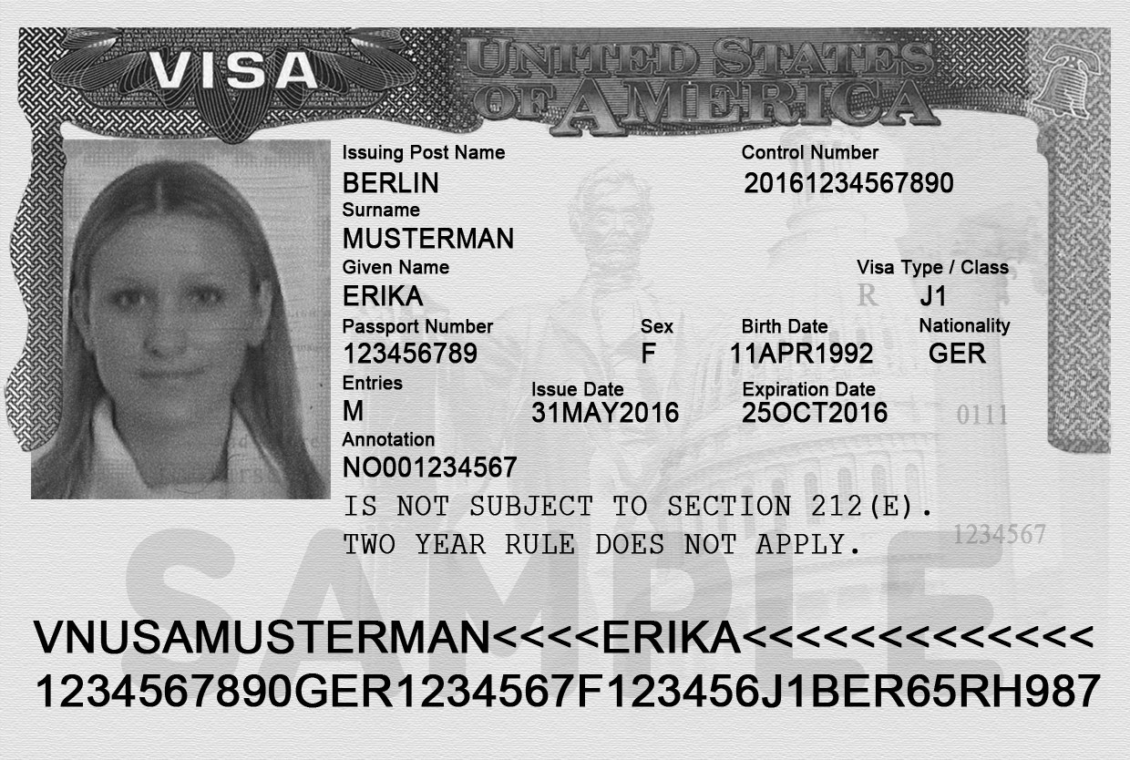
Two Year Home Residency Requirement
Some people in J status are subject to a Two Year Home Residency Requirement: the facts of your situation matter, not necessarily what it says on your visa
If you received government funding for your J program-all Fulbrights
If your country has your field of study on its Exchange Visitor Skills List
If your J program is for a Medical Residency Program
Center for International Services

Slide 9
Two Year Home Residency Requirement
If you are subject to the Two Year Home Residency Requirement:
cannot change status within the U.S.
are not eligible for an H, K or L visa
are not eligible for permanent residence in the U.S.
UNTIL you have been physically present in your home country for two years
Center for International Services

Slide 10
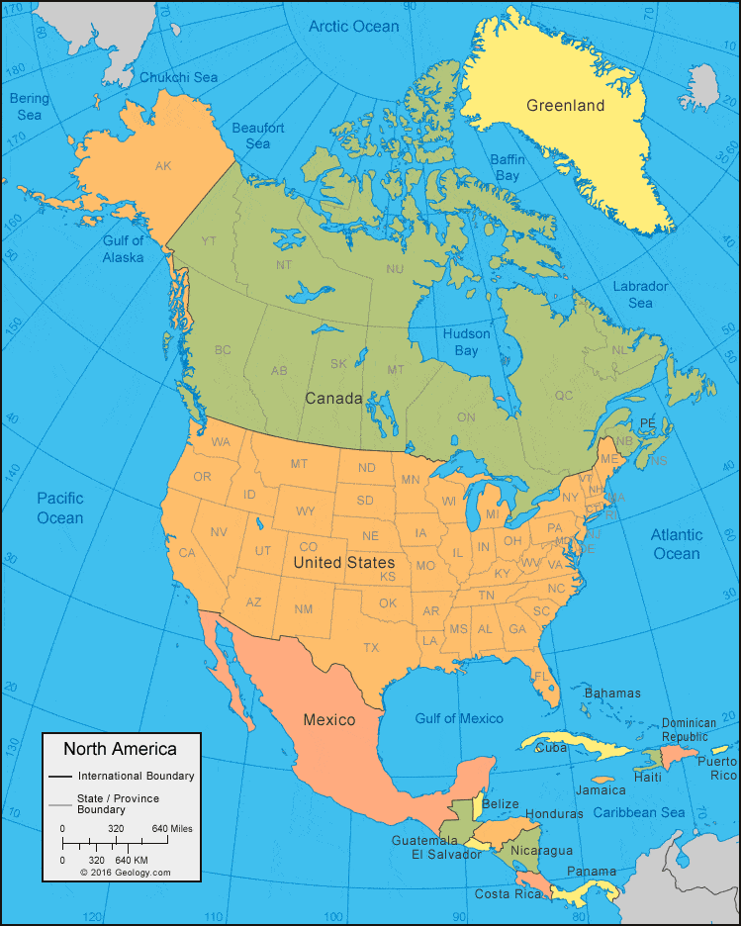
Travel
Visa needs to be valid to enter the U.S.
Exception:
Returning to the U.S. after a trip to Canada, Mexico, or the adjacent islands
Trip of less than 30 days
Trip solely to Canada, Mexico, or the adjacent islands
Cannot apply for U.S. Visa while there
Not a citizen of Iran, Syria, Sudan, or North Korea
But need to determine if you need a visa to travel to other countries
Center for International Services

Slide 11
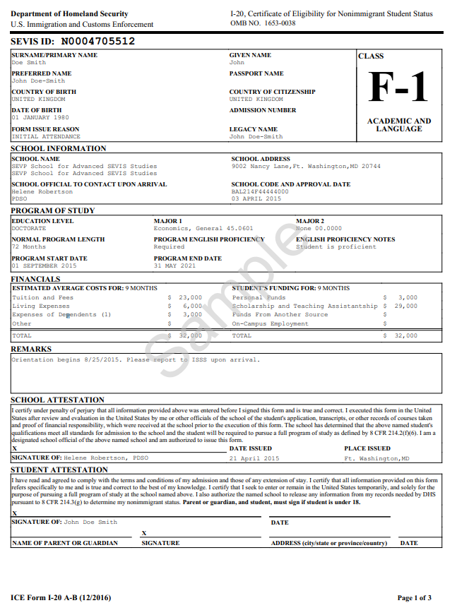
I-20
Immigration Selfie-tells your story
Issued by Syracuse University
Biographic Information about you
Degree Level
Program of Study
Program Start and End Date
Financial Information
Center for International Services

Slide 12
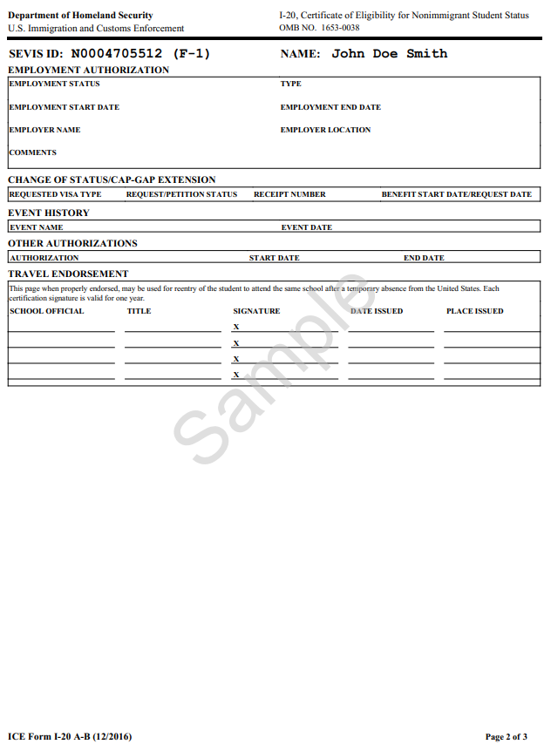
I-20 - Page 2
Employment Authorizations
Travel Endorsement
Travel Signatures-valid for one year/12 months
Ann Dievendorf International Student Advisor 07/30/2021 Syracuse,NY
Travel Signatures October 11-15
Monday-Friday
9 am-4 pm Bird Library
Center for International Services

Slide 13
DS-2019
Immigration Selfie-tells your story
Issued by Syracuse University or J-1 Program Sponsor
Biographic Information about you
Degree Level
Program of Study
Program Start and End Date
Financial Information
Center for International Services

Slide 14
Travel Endorsement
Travel Signatures-valid for one year/12 months
Travel Signatures October 11-15
Monday-Friday
9 am-4 pm Bird Library
07/30/2021
Center for International Services

Slide 15
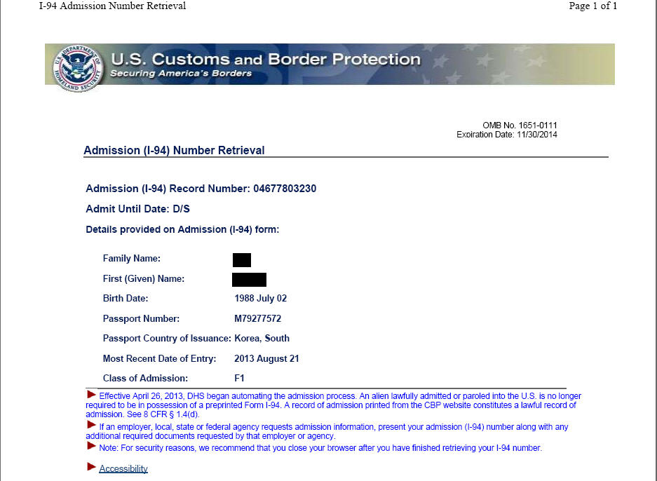
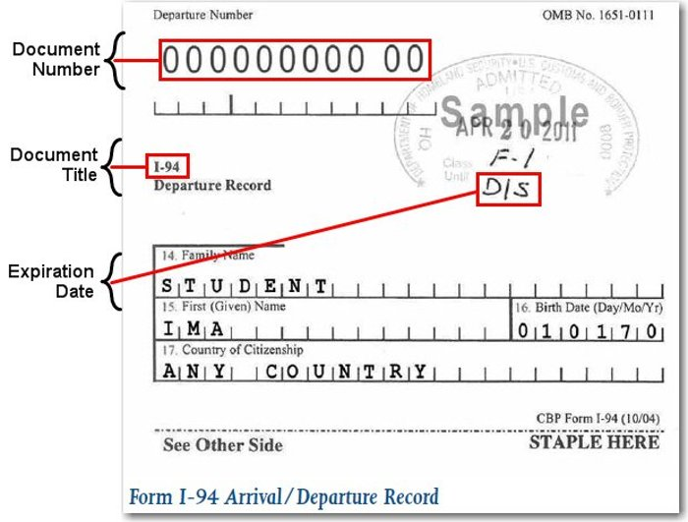
I-94 Arrival Record/Travel History
www.cbp.gov/I-94
Updated every time you travel out of the U.S. and enter
Check every time to be sure you were admitted to the US in F-1 status and for D/S
D/S = Duration of Status
Program End Date + 60 days
(F-1s)/30 days (J-1s) to prepare to depart or change status
Center for International Services

